Slide 1
Introduction
Module-1

Slide 2
What is Java?
Java is a programming language and a Platform:
Java Platform??
Execution engine, a compiler and a set of libraries

Slide 3
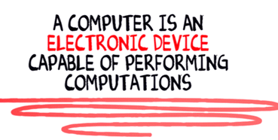
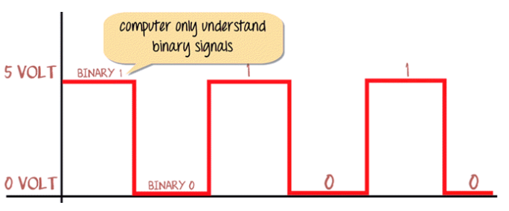
What is a computer?

Slide 4
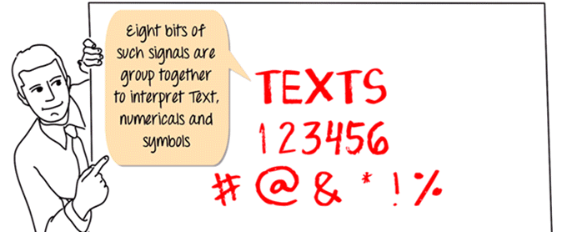
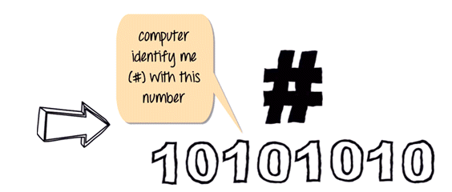

Slide 5
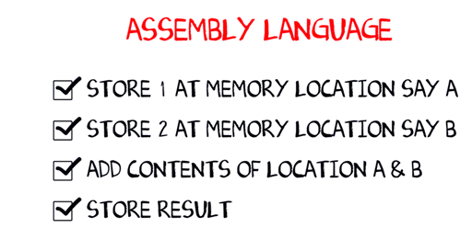
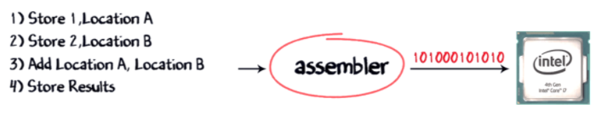
What are Assembler and Compiler?

Slide 6
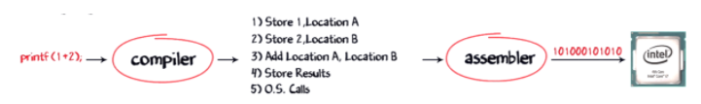
Now, suppose Windows operating system is running on this Intel processor, a combination of Operating System plus the processor is called the PLATFORM. The most common platform in the world is the Windows, and Intel called the Wintel Platform. The other popular platforms are AMD and Linux, Power PC, and Mac OS X.
As a developer, I want my software program to work on all platforms available, to maximize my revenues. So I would have to buy separate compilers which convert my print f command into the native machine code.

Slide 7
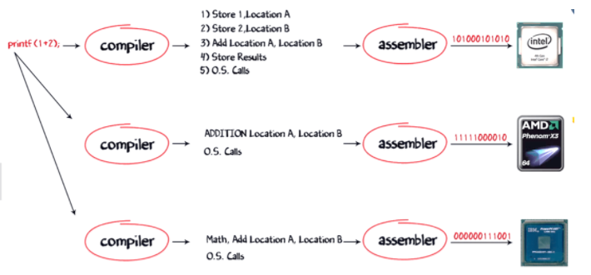

Slide 8
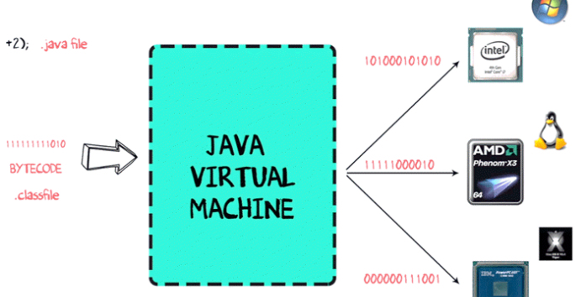
How Java Virtual Machine works?

Slide 9
How is Java Platform Independent?
Step 1) The code to display addition of two numbers is System.out.println(1+2), and saved as .java file.
Step 2) Using the java compiler the code is converted into an intermediate code called the bytecode. The output is a .class file.
Step 3) This code is not understood by any platform, but only a virtual platform called the Java Virtual Machine.
Step 4) This Virtual Machine resides in the RAM of your operating system. When the Virtual Machine is fed with this bytecode, it identifies the platform it is working on and converts the bytecode into the native machine code.
Bytecode is understandable to any JVM installed on any OS. In short, the java source code can run on all operating systems.

Slide 10
Software Code Compilation & Execution process
In order to write and execute a software program, you need the following
1) Editor – To type your program into, a notepad could be used for this
2) Compiler – To convert your high language program into native machine code
3) Linker – To combine different program files reference in your main program together.
4) Loader – To load the files from your secondary storage device like Hard Disk, Flash Drive, CD into RAM for execution. The loading is automatically done when you execute your code.
5) Execution – Actual execution of the code which is handled by your OS & processor.

Slide 11
Why is Java slow?
The two main reasons behind the slowness of Java are
Dynamic Linking: Unlike C, linking is done at run-time, every time the program is run in Java.
Run-time Interpreter: The conversion of byte code into native machine code is done at run-time in Java which furthers slows down the speed
However, the latest version of Java has addressed the performance bottlenecks to a great extent.

Slide 12
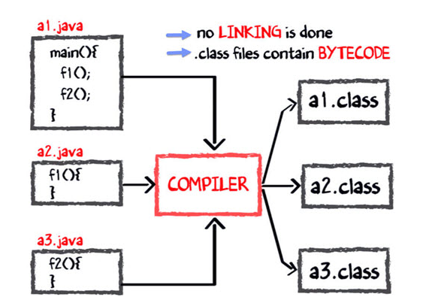
Java code Compilation and Execution in Java VM The main method is stored in file a1.java f1 is stored in a file as a2.java f2 is stored in a file as a3.java

Slide 13
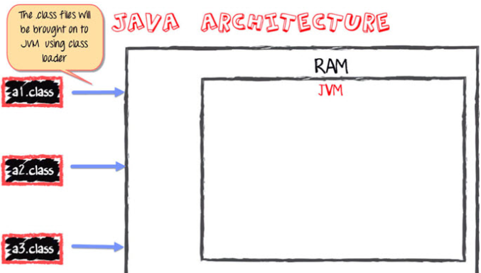

Slide 14
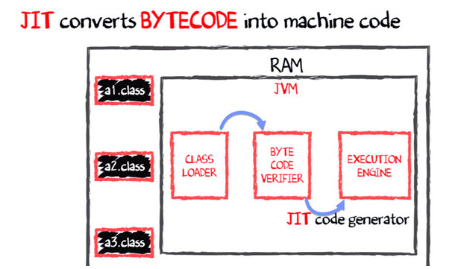

Slide 15
Introduction
What is Java
Java is a programming language and a platform.
Platform: Any hardware or software environment in which a program runs, is known as a platform. Since Java has its own runtime environment (JRE) it is called platform.
Notes:
There are so many companies who are manufacturing the processors some of the company names are INTEL, SUN, AMD and etc. the processors are responsible to execute the programs.
We have developed a ‘C’ program to add the numbers. The ‘C’ program developed in high level language. If we take the same .exe file and try to run it on sun processor it won’t be executed because sun processor can not execute the “INTEL PROCESSOR” instructions.
Using Java: By taking the help of JAVA compiler we have converted .JAVA programming to .class file. If we would like to run the java application we need to give .class file as Input to JVM. It is the responsibility of JVM to convert java instructions into processor dependent instructions.

Slide 16
JDK vs JRE
The Java Development Kit (JDK) is a software development environment used for developing Java applications and applets. It includes the Java Runtime Environment (JRE), an interpreter/loader (Java), a compiler (javac), an archiver (jar), a documentation generator (Javadoc) and other tools needed in Java development.
JAVA RUNTIME ENVIRONMENT
JRE stands for “Java Runtime Environment” and may also be written as “Java RTE.” The Java Runtime Environment provides the minimum requirements for executing a Java application; it consists of the Java Virtual Machine (JVM), core classes, and supporting files.
Notes:
To compile and run a java program we use javac and java commands.But these commands are unknown to your OS until we explicitly specify the location of these executable files. This is the main reason why we need to set path in Java and while specifying the path we specify the path of bin folder which contains the executable files.

Slide 17
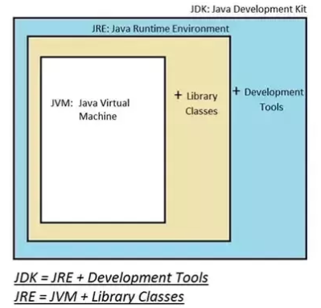
Difference between JDK, JRE and JVM

Slide 18
Difference between JDK, JRE and JVM
JDK – Java Development Kit (in short JDK) is Kit which provides the environment to develop and execute(run) the Java program. JDK is a kit(or package) which includes two things
Development Tools(to provide an environment to develop your java programs)
JRE (to execute your java program).
Note : JDK is only used by Java Developers.
JRE – Java Runtime Environment (to say JRE) is an installation package which provides environment to only run(not develop) the java program(or application)onto your machine. JRE is only used by them who only wants to run the Java Programs i.e. end users of your system.
JVM – Java Virtual machine(JVM) is a very important part of both JDK and JRE because it is contained or inbuilt in both. Whatever Java program you run using JRE or JDK goes into JVM and JVM is responsible for executing the java program line by line hence it is also known as interpreter.

Slide 19
How to install JDK?
Step 1: Download JDK
Goto Java SE download site @ http://www.oracle.com/technetwork/java/javase/downloads/index.html.
Under "Java Platform, Standard Edition" ⇒ "Java SE 8u{xx}", where {xx} is the latest update number ⇒ Click the "JDK Download" button.
Look for the latest "Java SE Development Kit 8u{xx}" ⇒ Check "Accept License Agreement".
Choose the JDK for your operating system, e.g., "Windows x64" (for 64-bit Windows OS) or "Windows x86" (for 32-bit Windows OS). You can check whether your Windows OS is 32-bit or 64-bit via "Control Panel" ⇒ (Optional) System and Security ⇒ System ⇒ Under "System Type".

Slide 20
How to install JDK?
Step 2: Install JDK and JRE
Run the downloaded installer (e.g., "jdk-8u{xx}-windows-x64.exe"), which installs both the JDK and JRE. By default, the JDK will be installed in directory "C:\Program Files\Java\jdk1.8.0_xx", where xx denotes the upgrade number; and JRE in "C:\Program Files\Java\jre1.8.0_xx".
Accept the defaults and follow the screen instructions to install JDK and JRE.
Check the JDK installed directory by inspecting these folders using File Explorer. Take note of your JDK installed directory, in particular, the upgrade number, which you will need in the next step.
Step 3: Set path

Slide 21
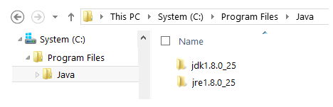
How to install JDK?
Step 3: Include JDK's "bin" Directory in the PATH
Windows Shell searches the current directory and the directories listed in the PATH environment variable (system variable) for executable programs. JDK's programs (such as Java compiler javac.exe and Java runtime java.exe) reside in directory "<JAVA_HOME>\bin“. We need to include "<JAVA_HOME>\bin" in the PATH to run the JDK programs.
To edit the PATH environment variable in Windows 7/8/10:
Launch "Control Panel" ⇒ (Optional) System and Security ⇒ System ⇒ Click "Advanced system settings" on the left pane.

Slide 22
How to install JDK?
Switch to "Advanced" tab ⇒ Push "Environment Variables" button.
Under "System Variables" (the bottom pane), scroll down to select "Path" ⇒ Click "Edit...".
For Windows 10 (newer releases):
You shall see a TABLE listing all the existing PATH entries (if not, goto next step). Click "New" ⇒ Enter the JDK's binary directory "c:\Program Files\Java\jdk1.8.0_xx\bin" (Replace xx with your installation number!!!) ⇒ Select "Move Up" to move this entry all the way to the TOP.
Step 4: Verify the JDK Installation
(Windows 10) click "Start" button ⇒ Windows System ⇒ Command Prompt

Slide 23
How to install JDK?
prompt> java -version
java version "1.8.0_xx"
Java(TM) SE Runtime Environment (build 1.8.0_xx-b13)
Java HotSpot(TM) 64-Bit Server VM (build 25.5-b02, mixed mode)

Slide 24
Java History
The history of java starts from Green Team. Java team members (also known as Green Team), initiated a revolutionary task to develop a language for digital devices such as set-top boxes, televisions etc.
James Gosling, Mike Sheridan, and Patrick Naughton initiated the Java language project in June 1991. The small team of sun engineers called Green Team.
Firstly, it was called "Greentalk" by James Gosling and file extension was .gt.
After that, it was called Oak and was developed as a part of the Green project.
Why Oak? Oak is a symbol of strength and chosen as a national tree of many countries like U.S.A., France, Germany, Romania etc.

Slide 25
Java History
In 1995, Oak was renamed as "Java" because it was already a trademark by Oak Technologies.
Java is an island of Indonesia where first coffee was produced (called java coffee).
Originally developed by James Gosling at Sun Microsystems (which is now a subsidiary of Oracle Corporation) and released in 1995.
JDK 1.0 released in(January 23, 1996).

Slide 26
Java Version History
There are many java versions that has been released. Current stable release of Java is Java SE 8.
JDK Alpha and Beta (1995)
JDK 1.0 (23rd Jan, 1996)
JDK 1.1 (19th Feb, 1997)
J2SE 1.2 (8th Dec, 1998)
J2SE 1.3 (8th May, 2000)
J2SE 1.4 (6th Feb, 2002)
J2SE 5.0 (30th Sep, 2004)
Java SE 6 (11th Dec, 2006)
Java SE 7 (28th July, 2011)
Java SE 8 (18th March, 2014)

Slide 27
Introduction
Java is a high level, robust, secured and object-oriented programming language.
There are mainly 4 types of applications that can be created using java programming:
1) Standalone Application
It is also known as desktop application or window-based application. An application that we need to install on every machine such as media player, antivirus etc. AWT and Swing are used in java for creating standalone applications.
2) Web Application
An application that runs on the server side and creates dynamic page, is called web application. servlet, jsp, struts, jsf etc. technologies are used for creating web applications in java.

Slide 28
Introduction
3) Enterprise Application
An application that is distributed in nature, such as banking applications etc. It has the advantage of high level security, load balancing and clustering. In java, EJB is used for creating enterprise applications.
4) Mobile Application
An application that is created for mobile devices. Currently Android and Java ME are used for creating mobile applications.

Slide 29
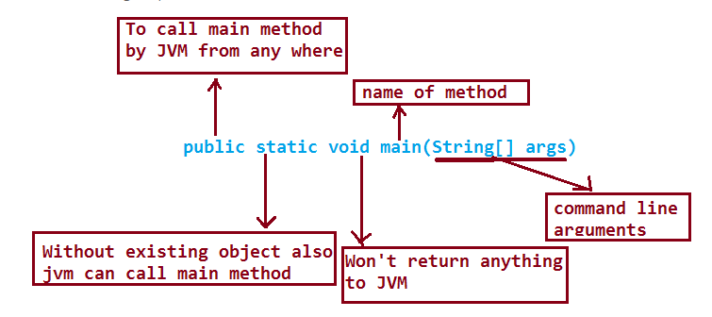
main Method Explanation
At compilation time ,compiler won’t check whether our class contains main() method or not and whether it is properly declared or not.
At runtime JVM is responsible to check main() method declaration.
If main method is not available or it is not properly declared JVM will throw an error message saying NoSuchMethodError:main
JVM always checks main method with the following declaration .

Slide 30
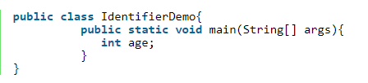
Identifier
A name in the program is an identifier, It may be class name or method name or variable name or label name.
Rules for defining Identifiers
An identifier consists of a sequence of characters, where each character is a letter from a-z or A-Z or a digit form 0-9 or currency symbol $ or connecting punctuation _(underscore), if we are using any other symbol we will get compile time error saying “IllegalCharacter”.
The first character in an identifier should not be a digit.
Notes:
In the above program IdentifierDemo,main,String,args and age are the identifiers.

Slide 31
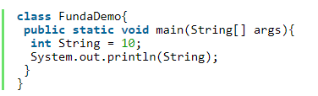
Identifier
Example: total123 is a valid identifier 891total is not a valid identifier
There is no length limit for java identifiers, but it is not recommended to take more than 15 character length.
The java identifiers are case sensitive
keywords/reserved words are not allowed to used as a identifiers
We can use all predefined java class names and interface names as identifiers
Notes:
In the above program String is class.

Slide 32
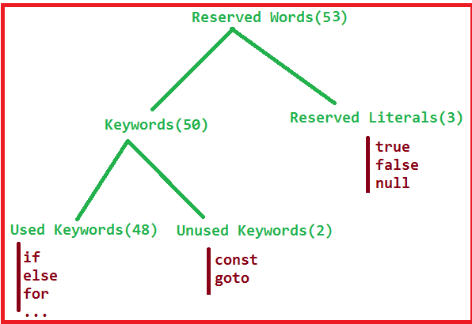
Java Reserved words & Keywords
Some identifiers are reserved words in java to represent literal and to define some functionality ,such type of reserved identifiers are called “reserved words”

Slide 33
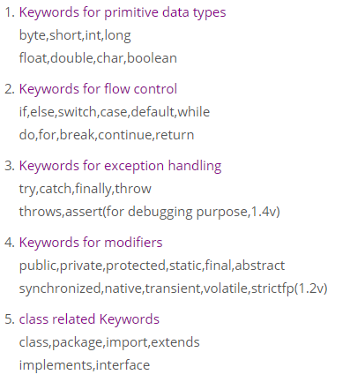
Java Reserved words & Keywords

Slide 34
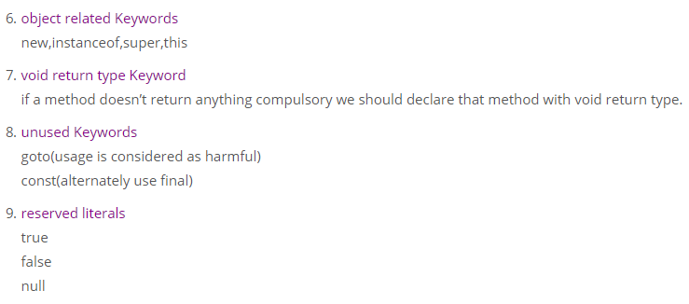
Java Reserved words & Keywords s

Slide 35
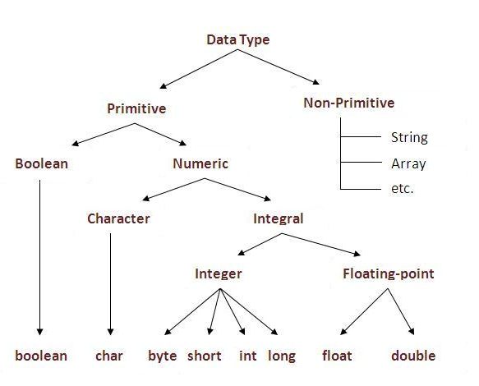
Data Types

Slide 36
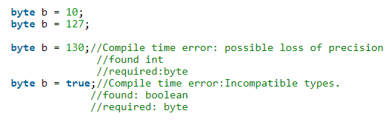
Data Types
byte
Size : 8-bits (1 byte)
Range: -128 to 127
-ve numbers can represented in 2’s compliment form.
byte datatype is best suitable if we are handling data in the from of streams either from the file or from the network.
Notes:
Note: File supported form and network supported form data type is byte.
Class FileOutputStream contains write method, whose argument is byte array.

Slide 37

Data Types
short
size = 2 bytes range = -2¹⁵ to 2¹⁵-1 (-32768 to 32767)
short is best suitable datatype for 16-bit process. But currently these are completely outdated and hence the corresponding data types also no one is using.

Slide 38
Data Types
int
The most commonly used datatype is int. size = 4 bytes range = -2³¹ to 2³¹ – 1(-2147483648 to 2147483747) The size of int is always fixed irrespective of platform and the chance of failing java program is very less if you are changing the platform, hence the java is considered as Robust.
long
if int is not enough to hold big values then we should go for long datatype size = 8 bytes range = -2⁶³ to 2⁶³ – 1 Example: The amount of distance travelled by light in 1000 days can be represented by long datatype only and int is not enough.
Notes:
Note: file contains lacks of pages, hundred of lines and hundreds of characters, we use f.length() method to hold number of characters in the file whose return type is long not int

Slide 39

Data Types
float is represented in 32 bits, with 1 sign bit, 8 bits of exponent, and 23 bits of the significand (or what follows from a scientific-notation number: 2.33728*1012; 33728 is the significand).
double is represented in 64 bits, with 1 sign bit, 11 bits of exponent, and 52 bits of significand.
By default, Java uses double to represent its floating-point numerals (so a literal 3.14 is typed double).
Notes:
Note: All transcendental math functions, such as sin( ), cos( ), and sqrt( ), return double values. When you need to maintain accuracy over many iterative calculations, or are manipulating large-valued numbers, double is the best choice.

Slide 40
Data Types
boolean data type
size = not applicable(virtual machine dependent). range = not applicable but allowed values are true/false.
Which of the following boolean declarations are valid?
boolean b1 = true; //valid
boolean b2 = 0; //C.E Incompatible types found: int required : Boolean
boolean b3 = True; //C.E capital TRUE is not valid
Boolean b4= “true”; // C.E Incompatible types
Notes:
Compile time error: Incompatible types found :int required: boolean.

Slide 41
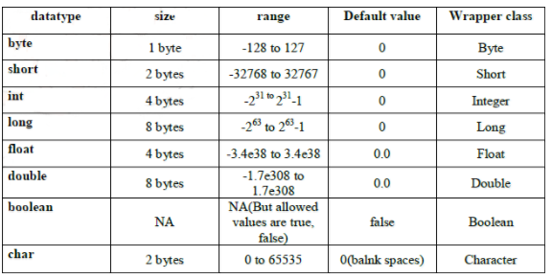
Data Types
char data type
java provides support for Unicode i.e it supports all world wide alphabets. Hence the size of char in java is 2 bytes and range is 0 to 65535.

Slide 42
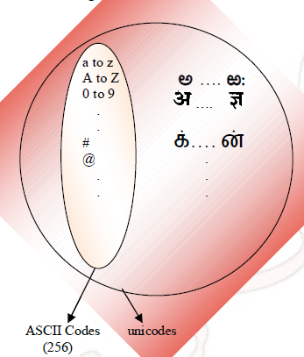
Unicode system
char
java provides support for Unicode i.e it supports all world wide alphabets. Hence the size of char in java is 2 bytes.
Notes:
Old languages(like C or C++ are ASCII code based and the number of allowed different ASCII code characters are less than or equal to 245. To represent these 256 characters, 8 bits are enough. Hence, the size of char in old languages is 1 byte.
But java is unicode based and the number of different unicode characters are greater then 256 and less then or equal to 65536. To represent these many characters, 8 bits may not enough.
Example: A-97 AsCII and unicode values are same
A-97 AsCII and unicode values are same

Slide 43
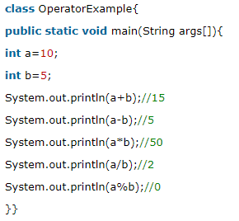
Operator
Arithmetic Operators
Arithmetic operators are used to perform fundamental arithmetic operations like addition, subtraction etc.
There are 5 arithmetic operators in java and these operators act on two operands at a time, hence these are called as “Binary Operators.“
Notes:
15
5
50
2
0

Slide 44
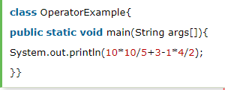
Arithmetic Operators
When ever we are applying any arithmetic Operator on two operands a and b the result type is Syntax: max(int,type of a,type of b)
Notes:
Output: 21

Slide 45
Arithmetic Operators
Example:
byte a=120;
byte b=125;
byte c=a + b;
sop(c); //Compile time error
Resolve compile time error by typecasting
byte c=(byte) (a+b); //30
Notes:
Example:
double+float=double max(int,double,float)
double+char=double
short+byte=int max(int,short,byte)
byte*short=int
int+long=long
byte+long=long

Slide 46
Example-2 (Infinity)
In the integral arithmetic, there is no way to represent Infinity hence “division/0” is always ” ArithmeticException” in integral arithmetic.
system.out.println(10/0); //RuntimeException
But in the case of floating point arithmetic there is a way to represent Infinity. Float and Double classes contains the following constants.
POSITIVE_INFINITY
NEGATIVE_INFINITY
Hence division by zero is not “ArithmeticException” in floating point arithmetic.
System.out.println(10.0/0); //Infinity
System.out.println(10/0.0); //Infinity
System.out.println(-10.0/0); //-Infinity

Slide 47
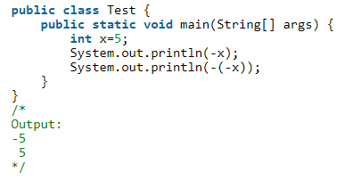
Unary Operators
unary Operators act on only one operand. There are 3 kinds of unary operators
unary minus operator(-)
Increment operator(++)
Decrement operator(–)
Unary minus operator(-): This operator is used to negate a given value.

Slide 48
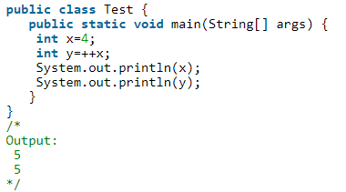
Increment/decrement operator
Increment operator(++)
Writing ++ before a variable is called “Pre incrementation“
Writing ++ after a variable is called “Post incrementation“

Slide 49
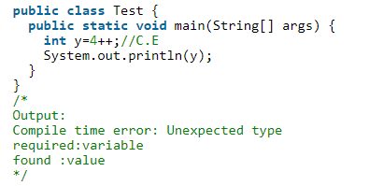
Increment/decrement operator
Case1: Increment/Decrement operators applicable only for variables but not for constant values

Slide 50
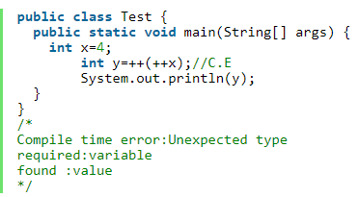
Increment/decrement operator
Case2: We can’t nest increment and decrement operators.

Slide 51
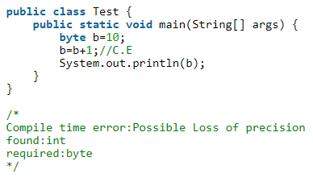
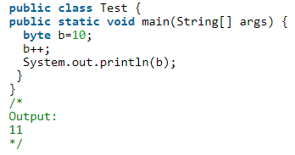
Increment/decrement operator
Case 3: In the case of increment/decrement operators, internal type casting is performed by the compiler hence ,b++=>(type of b)(b+1)

Slide 52
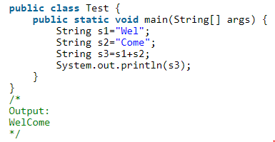
String Concatenation & Assignment Operators
String Concatenation Operator(+)
The only overloaded operator in java is ‘+’ operator. Some times it acts as arithmetic addition operator some times it acts as “String concatenation Operator”

Slide 53
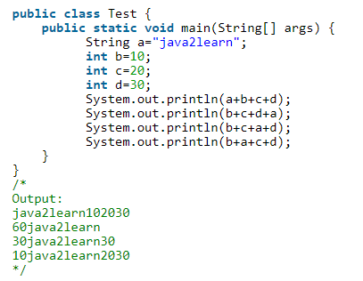
String Concatenation operator
Case 1: If at least one operand is String type then ‘+’ operator acts as concatenation otherwise it acts as arithmetic addition operator.

Slide 54
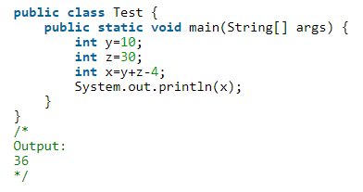
Assignment Operator(=)
This operator is used to store some value into a variable. It is used in 3 ways:
It is used to store a value into a variable Example: int x=5;
It is used to store the value of a variable into another variable. Example: int x=y;//Here the value of y is stored into x.
It is use to store the value of an expression into a variable.

Slide 55
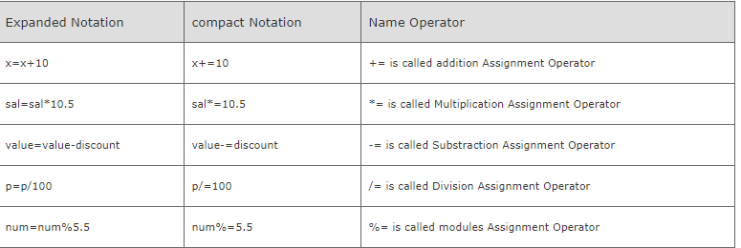
Compound assignment operator (OR)compact Notation

Slide 56
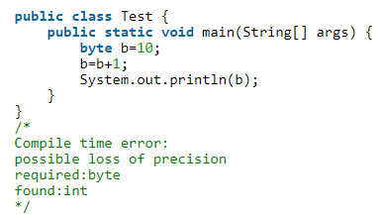
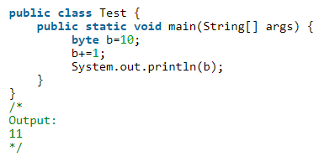
Compound assignment operator (OR)compact Notation
Case 1: In the case of compound assignment operators compile will perform the required implicit type Casting that is b+=1=>b=(byte)(b+1);

Slide 57
Relational & Equality Operators
Relational Operators
These Operators are used for the purpose of comparing values.
>(greater than operator)
>=(greater than or equal to operator)
< (less than operator)
<=(less than or equal to operator)
Case 1: Relational Operators are applicable only for primitive types except boolean.
Case 2: we can not perform nesting of relational operator:

Slide 58
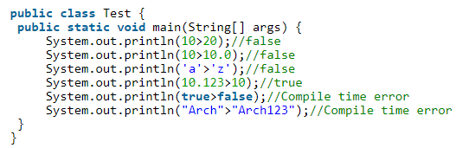
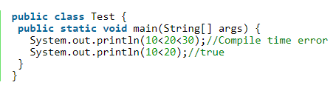
Relational & Equality Operators

Slide 59
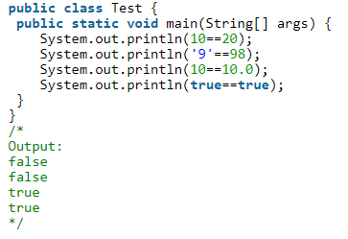
Equality Operators(==,!=)
Imp: We can apply equality operators even for object references also
r1==r2 returns true, if and only if both r1 and r2 pointing to the same object on the heap (reference comparison)
To use the == operator, there should be some relation b/n the types of r1 and r2 (either parent to child/child to parent/same type), otherwise we will get compile time error saying “Incomparable types”

Slide 60
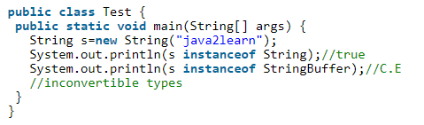
instanceOf & new operator
instanceOf operator
This operator is used to test if an object belongs to the class or not.
Word ‘instance’ means object.
This operator can also be used to check if an object belongs to an interface or not

Slide 61
Cast operator
new operator
This operator can be used for creating objects.Objects are created on heap memory by JVM. There is no delete operator in java,Garbage collector is responsible for deleting the objects.
Syntax: classname obj=new Classname();
Cast operator
cast Operator is used to convert one data type into anotherdatatype. primitive type casting:There are two types of primitive type castin
implicit typecasting
explicit type casting

Slide 62
Cast operator
implicit type casting:
compile is responsible for this type casting
This type of typecasting is required when ever we are assigning smaller data type value to the bigger data type variable
It is also known as “Widening” or “upcasting”.
No loss of information in implicit type castings
The following are all possible implicit type casting byte—>short—–>int—->long—->float—–>double

Slide 63
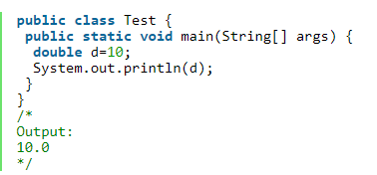
Cast operator
Compiler automatically converts int value to the double type by implicit type casting
Explicit type casting:
It is the responsibility of programmer.
It requires, when ever we are assigning bigger data type value to the smaller datatype variable

Slide 64
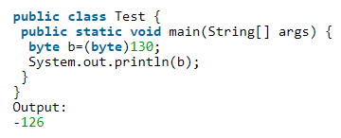
Cast operator
There may be a chance of loss of information
The following are all possible conversions which requires explicit type casting.

Slide 65
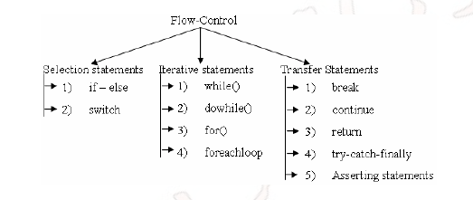
Control Statements: if, else, switch, for, while, do while, break, continue
Flow control describes the order in which all the statements will execute at run time.

Slide 66
Flow Control
Flow control describes the order in which all the statements will execute
at run time.

Slide 67
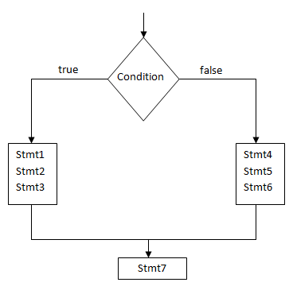
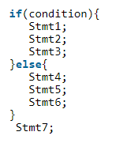
if with else
Notes:
>In the above statements 1,2,3 are executed when condition is true.
>The statements:4,5,6 are executed when condition is false.
>Statement 7 is always executed since it is outside if.
>For every else corresponding if is necessary but not vice verse.
>If there are more than one statement, we should enclosed them in braces.
>Braces are not required for single statement.
>Condition must be enclosed in bracket, There is no semicolon at the end of the condition.

Slide 68
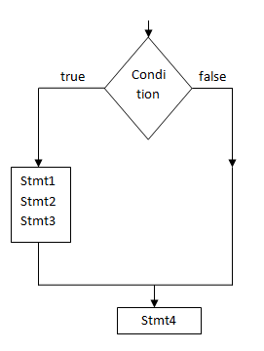
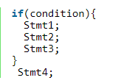
if without else
Notes:
>If condition is true statements 1,2,3 are executed.
>If condition is false nothing is executed, since else part is missing.
>Statement 4 is always executed since it is outside of if.
>For every if, else is not compulsory

Slide 69
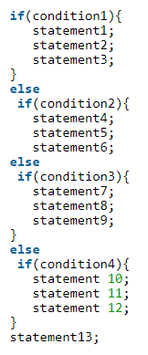

else if ladder & nested If
Notes:
>If within if is known as nested if.
>Only one condition is tested among condition 2,condition 3, it’s all depends on condition1.

Slide 70



Important cases:
CASE-1: Else part and curly braces are optional
CASE-2: Without curly braces ,Only one statement is allowed under if statement.
But it should not be declarative statement.

Slide 71

Important cases:
CASE-3: valid but no output will be provided

Slide 72



switch statement
When there are too many if statements in the program, it becomes difficult to understand the program.
Use switch statement as an alternative. It provides more clarity and better readability. Syntax:
The valid argument types to the switch statements are
Notes:
>Here depends on the value of variable, particular task(statements) will be executed.
>If the value of variable is equal to value1,Then statement 1,statement 2 will be executed.
>If the value of variable is equal to value2,Then statement 3,statement 4 will be executed.
>If the variable value is not equal to value 1 and value 2, then none of the statements will be executed, in that case default value is executed that is statement 5 and statement 6 are executed.

Slide 73
switch statement
break statement
When break statement is executed control goes out of switch.
Statements following break are skipped. Next statement is executed after break is, statement outside the switch.
break is used to suspend sequential execution.
if break is omitted, statements are in the next case are executed which is not desirable.

Slide 74




Some Important cases:
Syntax
CASE-1 Both case and default are optional
CASE-2: Within switch ,every statement should be under some case or default. We are not allowed to place individual statements.
CASE-3
Notes:
>curly braces are mandatory, except switch curly braces are optional for other flow controls.
>Between 0 and 1, infinite double values are present, therefore it is not allowed to have double type in switch

Slide 75

switch statement
CASE-4: Case labels should be constant expressions otherwise compile time error.

Slide 76
switch statement
case 5: switch argument and case label can be expressions. But, case label must be constant expression. Example:
int x=10;
switch(x+1)
{
case 10
System.out.println(10);
break;
case 10+20+30
System.out.println(50);
break;
}

Slide 77

Which of the option is valid?
A.
byte x=128;
switch(x+100)
{
case 10
System.out.println(10);
break;
case 1000
System.out.println(50);
break;
}
B.
Notes:
A is invalid here, 1000 is beyond the range of byte (-127 to 128)

Slide 78
Question?
A.
int x=10;
switch(x)
{
case 97
System.out.println(10);
break;
case 98
System.out.println(50);
break;
case ‘a’
System.out.println(50);
}
Notes:
>A. Invalid: Duplicate case label is not allowed
>

Slide 79



Fall-through inside a switch
Notes:
>Within the switch, we can write default case anywhere but it is recommended to write as last case.

Slide 80
Conclusion:
Case label:
case label must be compile time constants.
case label must be in the range of switch argument.
case label can be expression also (only constant expression).
Duplicates are not allowed.
default case:
In the switch statement we can place default case any where but it is convention to take default case always at last.

Slide 81


Iterative statement
While loop:
Notes:
If we don’t know the number of iterations in advance then we should go for while loop otherwise
Syntax: While argument type must be boolean type
Statements in while loop are repeatedly executed as long as the condition is true.
Control goes out of the loop, the moment condition is false.
Statements outside while loop are executed when condition is false.
Curly braces are optional. without curly braces we can take only one statement and that statement never be declaration statement.

Slide 82

Questions?

Slide 83

Iterative statement

Slide 84

Iterative statement
Notes:
Every final variable will be replaced by the value at compile time only

Slide 85


Iterative statement
Notes:
If we want to execute loop body atleast once then we should go for do while
Statements in do-while loop are repeatedly executed as long as condition is true.
Control goes out of loop, the moment condition is false.
Statements outside the loop are executed, when condition is false.
Semicolon (;) after the condition indicates end of do while loop. In C++ while semicolon is optional

Slide 86

Iterative statement
Notes:
Curly braces are optional and without curly braces we are allowed to take only one statement between do and while, and that statement never be declarative statement.

Slide 87


Iterative statement

Slide 88


for loop
Notes:
Execute initialization.
Test the condition, if it is true, execute statements in the for loop.
Execute increment/decrement.
Test the condition again, If it is true, repeats steps 2 and 3.if condition is false control goes out of loop and execute statements outside the loop.
Statements in the for loop are executed repeatedly as long as condition is true.the moment condition is false control goes out of loop and statements outside the loop are executed.

Slide 89

for loop

Slide 90

for loop

Slide 91

for loop
Notes:
It can be any valid java expression which should return boolean value.
This condition expression is optional and default value is true

Slide 92

for loop

Slide 93

for loop
All three parts of for loop are independent of each other and are optional for(;;)

Slide 94

for loop

Slide 95

Nested for loop

Slide 96

for each loop(enhanced for loop)
The most convenient loop for iterating the elements of arrays and collections. This loop has introduced in Java 1.5 version

Slide 97
Transfer statements
break:
It can be used in the following places.
1) with in the loops to come out of the loop.
2) Inside switch statement to come out of the switch .
3) If we are using break any where else we will get a compile time error.
Ex 1:
int x = 0;
if(x!=5)
break;
System.out.println("if");

Slide 98
Transfer statements
Ex2:
for(int i=0;i<10;i++)
{
if((i == 2)
break;
System.out.print(i);
}
O/P:- 01

Slide 99
continue
1) we should use ‘continue’ only in the loops to skip current iteration & continue for the next iteration.
2) If we are using ‘continue’ any where except loops we will get compile time error saying “continue out side of loop”.
Ex:
for(int i=0;i<10;i++)
{
if(i== 2)
continue;
System.out.print(i);
}
O/P:-013456789

